Slide 1
Introduction to IoT-II
IoT resulting in Address Crunch
Connectivity Terminologies
IoT network Configuration
Gateway Prefix Allotment
Impact of mobility on addressing
Gateways
Multihoming
IPV4 Vs IPV6
Essential Building blocks of IoT
Sensors Vs Transducers
Types of Sensors
Errors

Slide 2
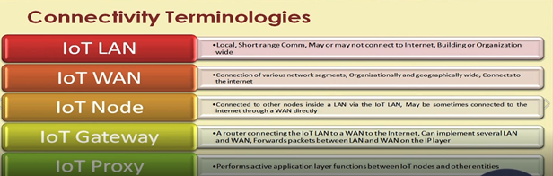

Slide 3
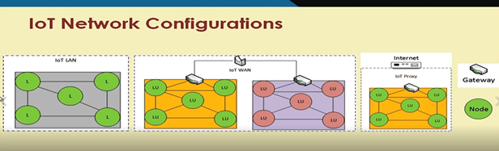

Slide 4
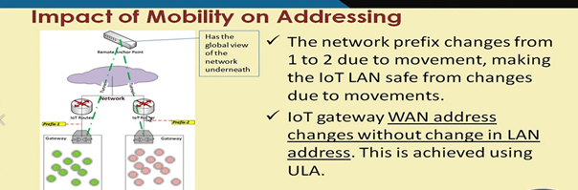

Slide 5
Gateways:
Gateways are responsible mainly for:
Internet Connectivity
IoT LAN intra-connectivity

Slide 6
Multi Homing:
A node/network connected to multiple networks for improved reliability.
Two Approaches:
Proxy based
Gateway based

Slide 7
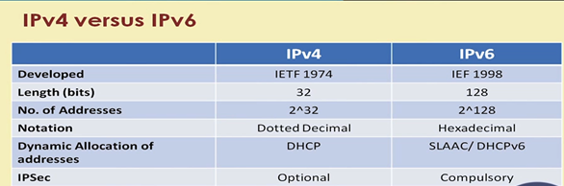
IPV4 Vs IPV6

Slide 8
Essential building blocks of IoT
Sensor
Actuator

Slide 9
Sensors:
Sensing the physical phenomena that are occurring around them.
Transducers:
Transducers convert or transduce energy of one kind to another.
Sensor Resolution:
Smallest change it can detect.

Slide 10
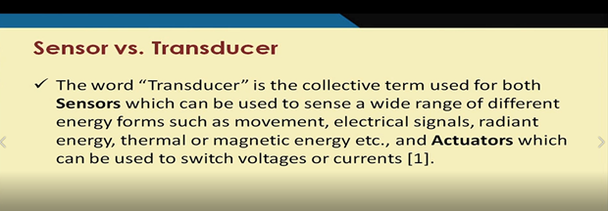
Sensor Vs Transducer:

Slide 11
Sensors Classes
Based on output:
Analog sensor
Digital sensor
Based on data type:
Scalar Sensors
Vector/Multimedia sensors

Slide 12
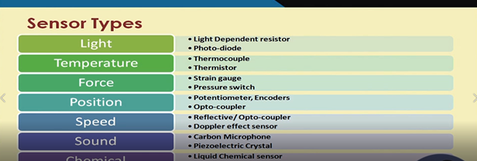
Types of Sensors

Slide 13
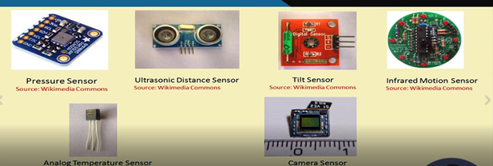

Slide 14
Errors
Sensorial deviations
Non linearity
Hysteresis error
Quantization error
Aliasing error

